Slide 1
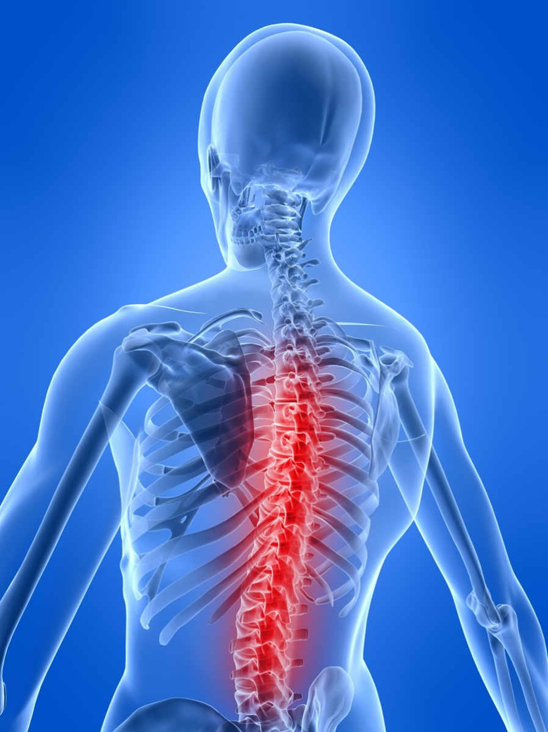
PTA/OTA 106 Unit 2 Lecture 6

Slide 2
Spinal Nerves
Cervical nerves 8 pairs
Thoracic Nerves 12 pairs
Lumbar Nerves 5 pairs
Sacral Nerves 5 pairs
Coccygeal Nerves 1 pair
Total 31 pairs

Slide 3
Spinal Plexuses and Nerves
Cervical Plexus (C1-C5)
Brachial Plexus (C5-T1)
Lumbar Plexus (L1-L4
Sacral Plexus (L4-S4)

Slide 4
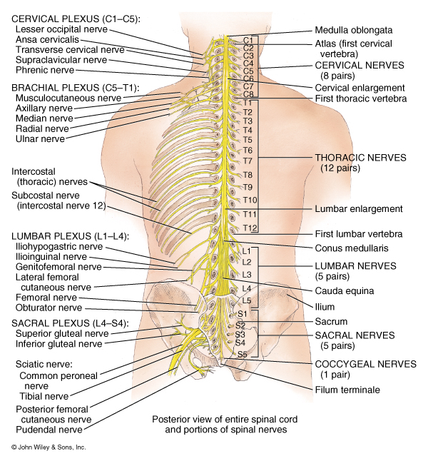

Slide 5
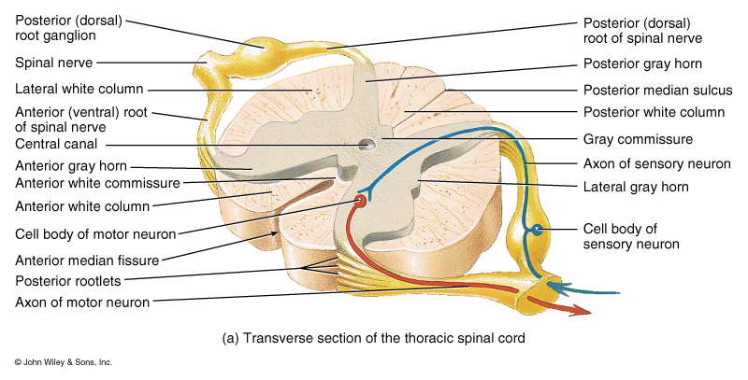
Gross Anatomy of the Spinal Cord

Slide 6
Functional Organization of the Nuclei within the Gray Matter of the Spinal Cord

Slide 7
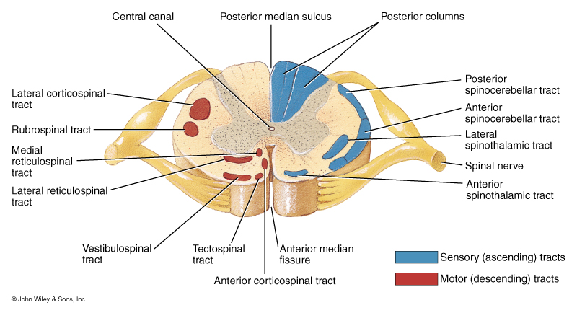
Location of Ascending and Descending Tracts of the Spinal Cord

Slide 8
Major Sensory or Ascending Tracts
Name | Location | Function
Fasciculus gracilis | Posterior Column | Discriminative touch, proprioception Weight discrimination
Fasciculus Cuneatus | Posterior Column | Same as FG
Lateral Spinothalamic | Lateral Column | Pain and Thermal sensations
Anterior Spinothalamic | Anterior Column | Itch, Tickle, Pressure, Crude touch sensations
Posterior and Anterior Spinocerebellar | Lateral Column | Proprioceptors

Slide 9
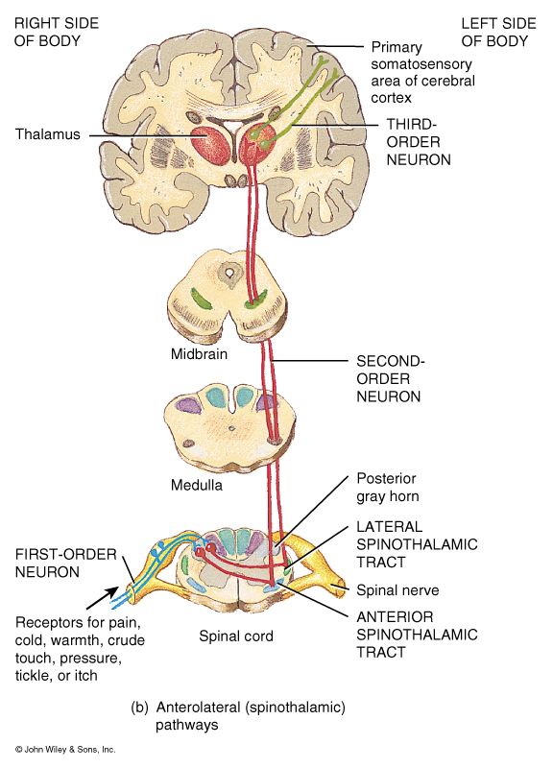
Organization of
Sensory or Ascending
Pathways

Slide 10
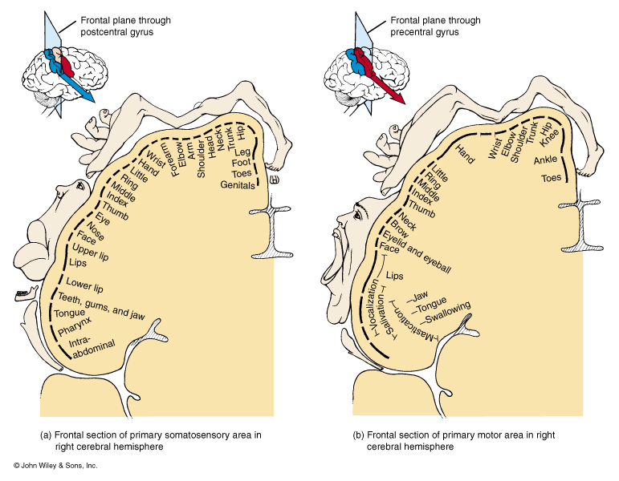

Slide 11
Motor or Descending Tracts of the Spinal Cord
Name | Location | Function
Lateral Corticospinal | Lateral Column | Muscles of the limbs, hands, and feet
Anterior Corticospinal | Anterior Column | Muscles of the axial skeleton
Corticobulbar | Cerebral Peduncle | Skeletal muscles of the head and neck via cranial nerves
Rubrospinal | Lateral Column | Skeletal muscles of the limbs, hands, and feet
Tectospinal | Anterior Column | Skeletal muscles of the head and eyes in response to visual stimuli

Slide 12
Motor or Descending Tracts of the Spinal Cord
Name | Location | Function
Vestibulospinal | Anterior column | Muscle for maintaining balance in response to head movements
Lateral reticulospinal | Anterior column | Facilitates flexor reflexes Inhibits extensor reflexes
Medial reticulospinal | Anterior column | Facilitates extensor reflexes Inhibits Flexor reflexes

Slide 13
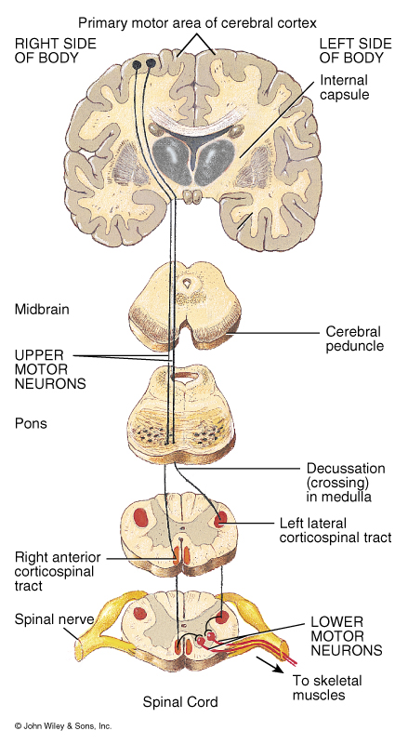

Slide 15
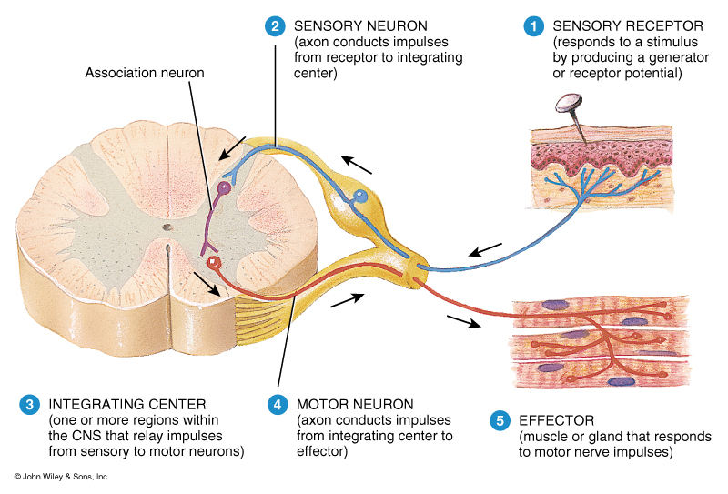
Basic Organization of a Reflex Pathway

Slide 16
Terms Associated with Reflex Pathways
Spinal Reflexes // Cranial Reflexes
Somatic Reflexes // Visceral (Autonomic) Reflexes
Monosynaptic Reflex // Polysynaptic Reflex
Ipsilateral Reflex // Contralateral Reflex
Segmental Reflex // Intersegmental Reflex
Reciprocal innervation

Slide 17
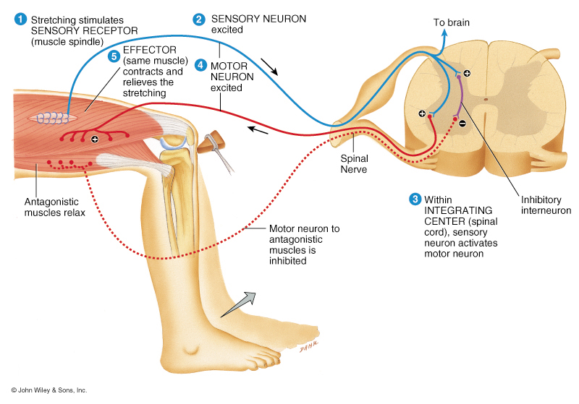
A Spinal, Somatic, Monosynaptic, Ipsilateral, Segmental Reflex demonstrating Reciprocal Innervation

Slide 18
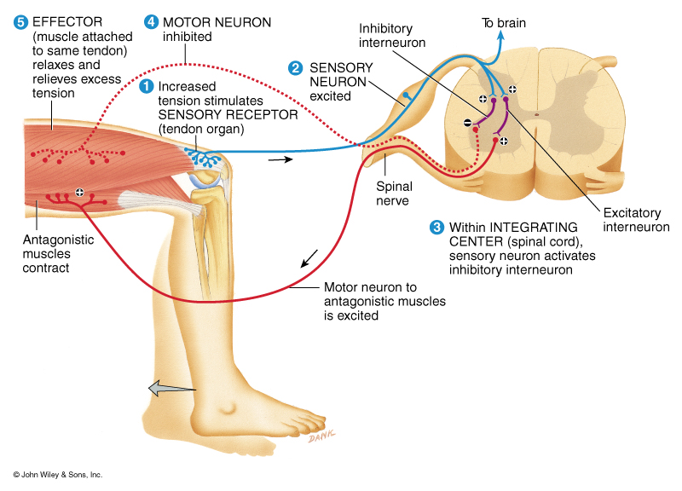
A Spinal, Somatic, Polysynaptic, Ipsilateral, Segmental Reflex demonstrating Reciprocal Innervation

Slide 19
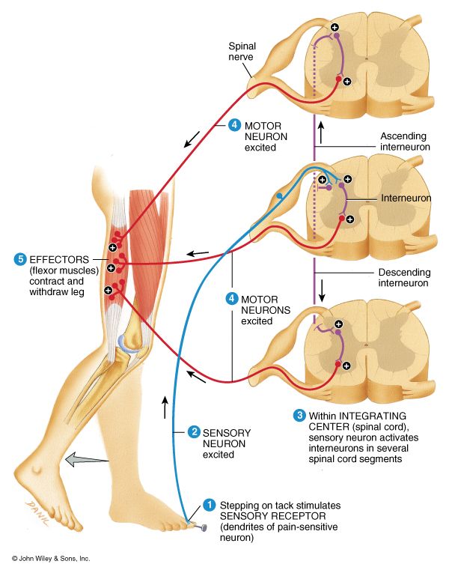
A Spinal, Somatic, Polysynaptic, Ipsilateral, Intersegmental Reflex demonstrating Reciprocal Innervation

Slide 20
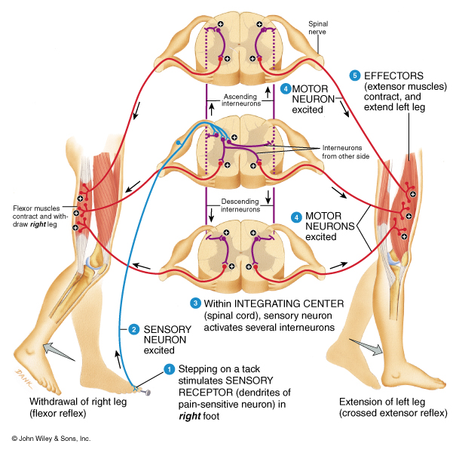
A Spinal, Somatic, Polysynaptic, Contralateral, intersegmental Reflex demonstrating Reciprocal Innervation

